Slide 1
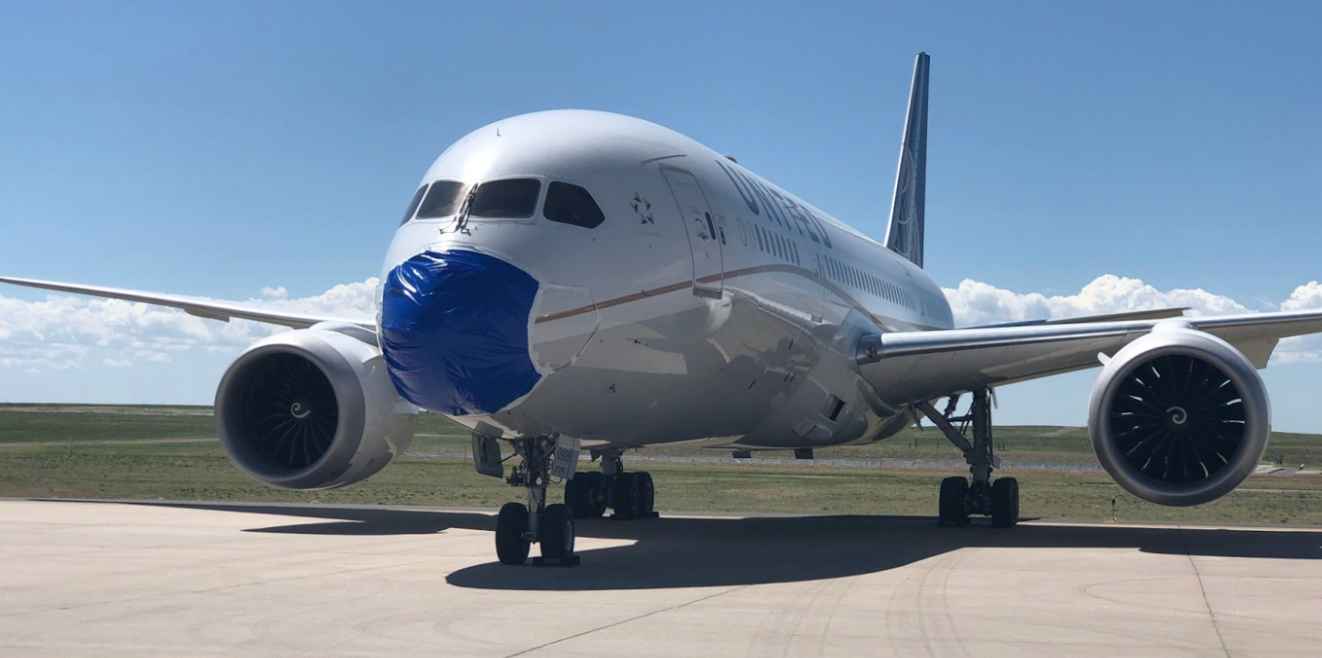
Visualising the Impact of COVID-19 on Global Air Traffic
Group 12

Slide 2





Main Objectives of the Project
Visualise the impact of the pandemic on some of the major airports and international routes
Compare the impact of the pandemic on air traffic to previous crises in the airline industry such as the aftermath of the Eyjafjallajökull volcano eruption in April 2010
Differentiate the impact of COVID-19 on commercial versus private air traffic
Visualise the impact on vertical flight efficiency and taxi-out time
Contrasting the impact of the first and second wave of COVID-19 on airlines

Slide 3

Background and
preparation

Slide 4


Sources
Information and Ideas
The Washington Post and Financial Times
EuroControl Aviation Intelligence Portal
The Official Aviation Guide (OAG)
Data
Crowdsourced air traffic data from The OpenSky Network
Data put together by the Eurocontrol Performance Review Commission (PRC)
Reported cases of Covid-19, European Centre for Disease Prevention and Control

Slide 5
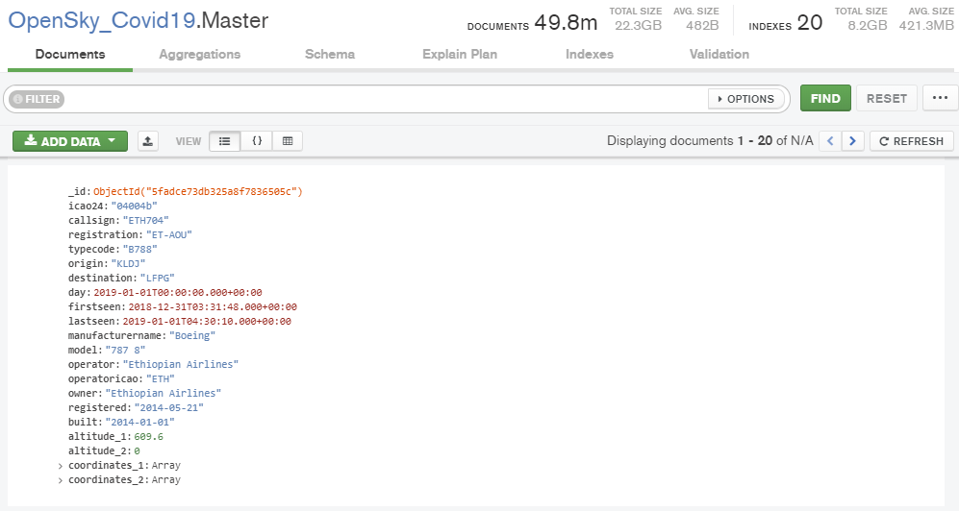
Data Preparation
49’756’482 Flights
1’291’015 Routes
171’325 Aircrafts
669 Days

Slide 6
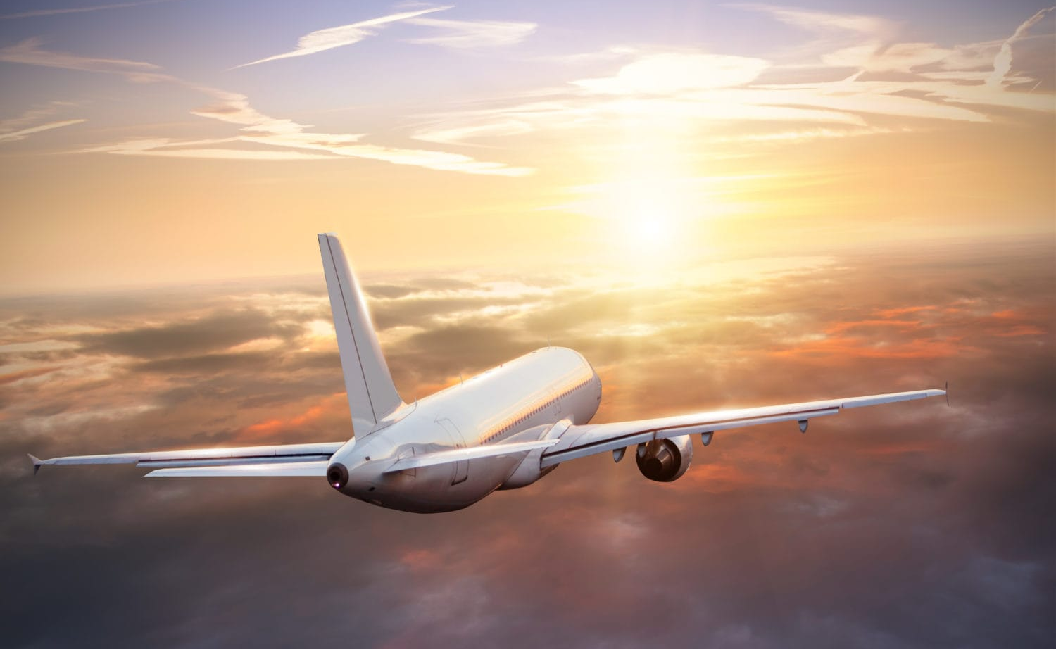
Impact on air traffic, routes and airports

Slide 7

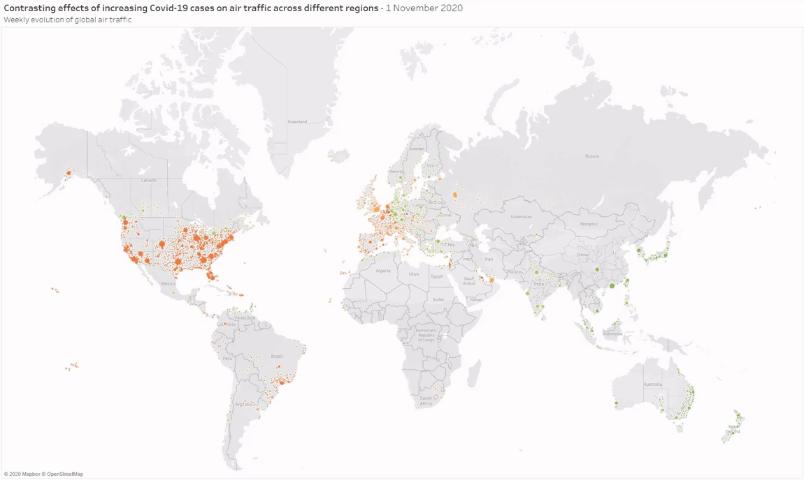
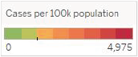

Slide 8
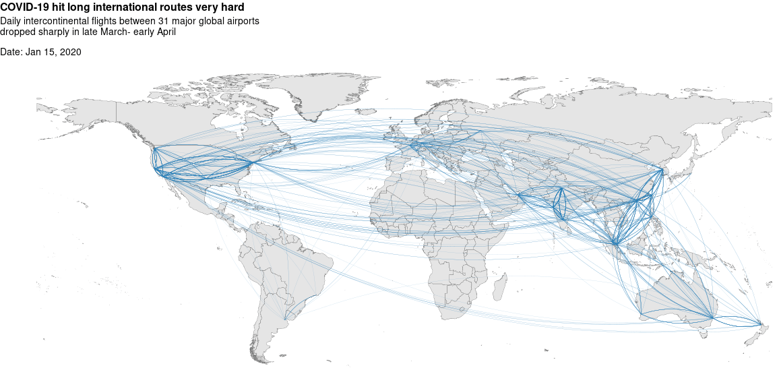

Slide 9
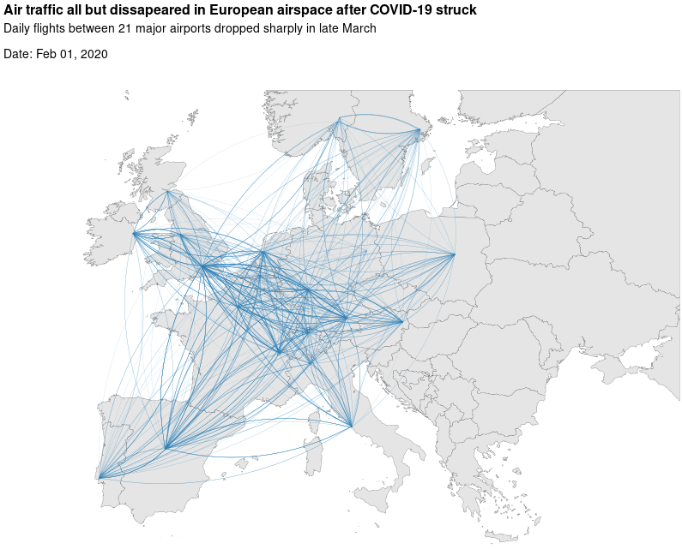

Slide 10
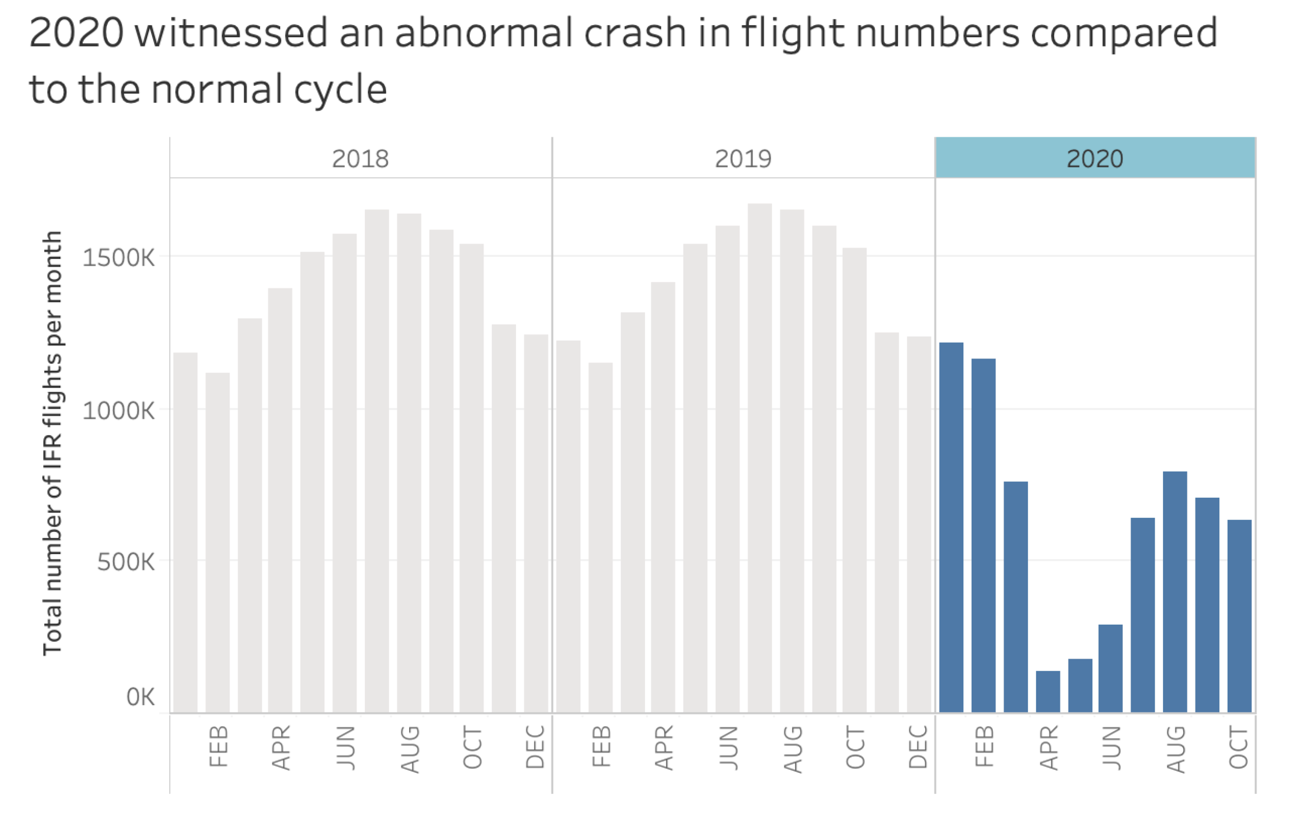

Slide 11
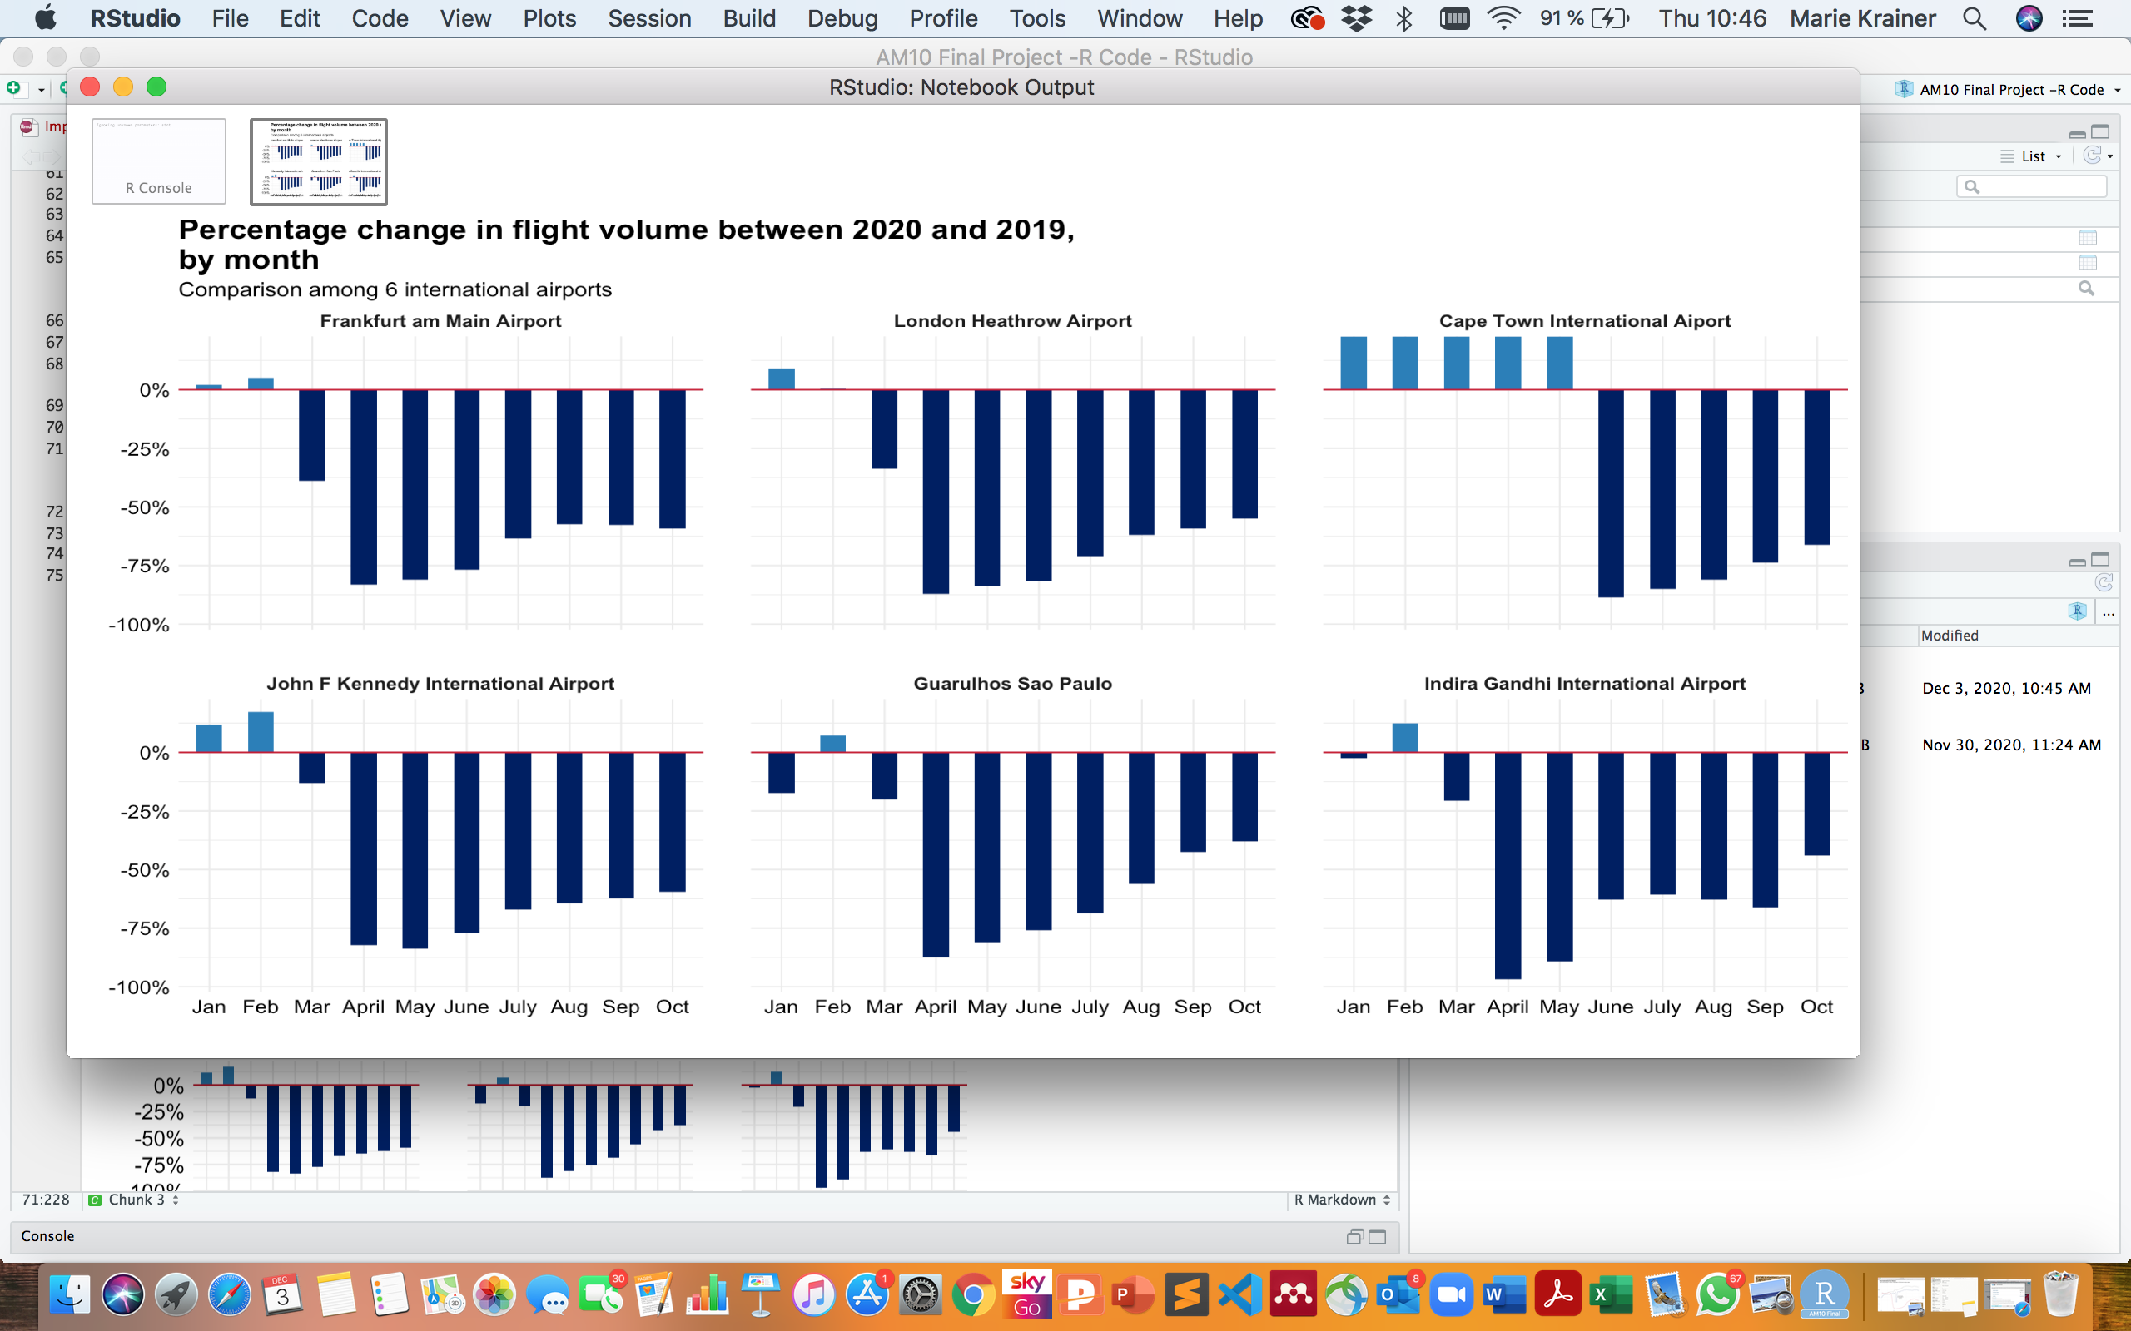

Slide 12
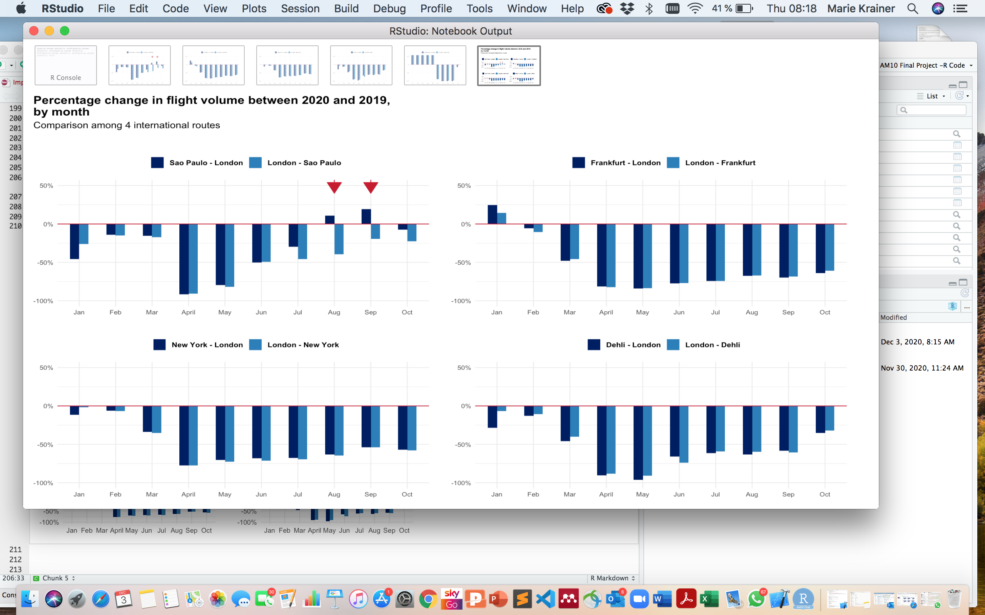

Slide 13
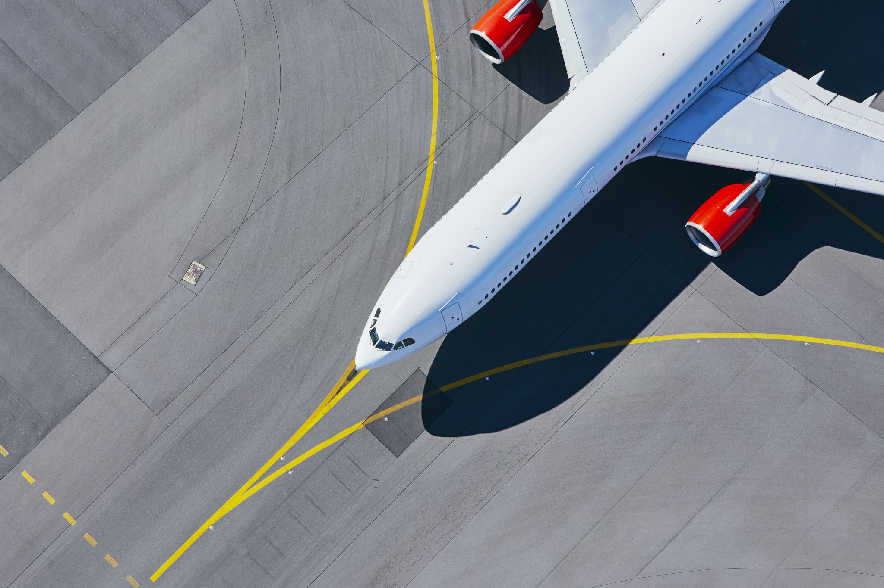
Comparison with previous air traffic crises

Slide 14

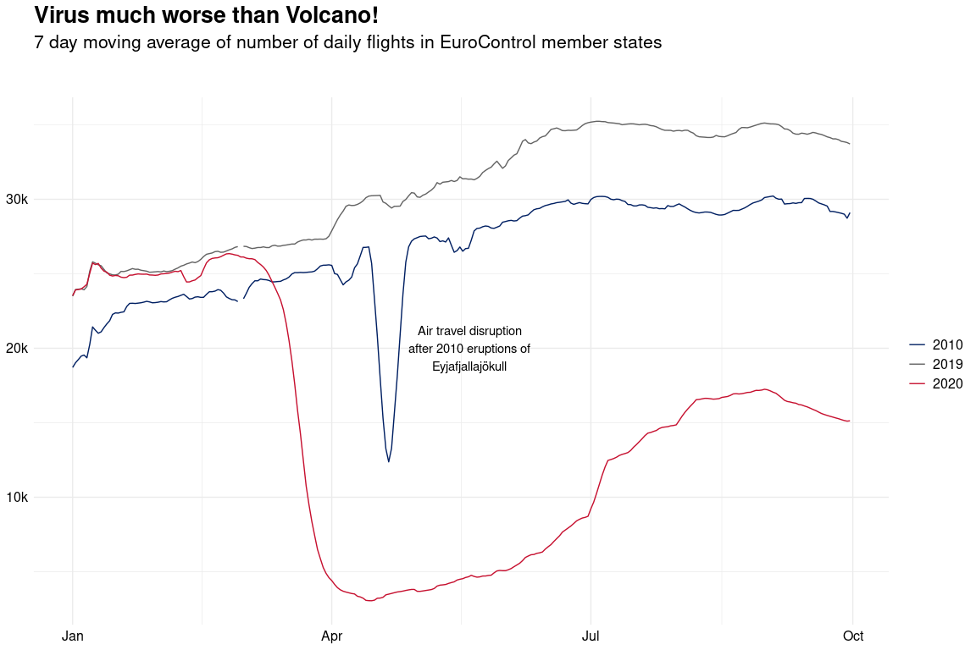

Slide 15
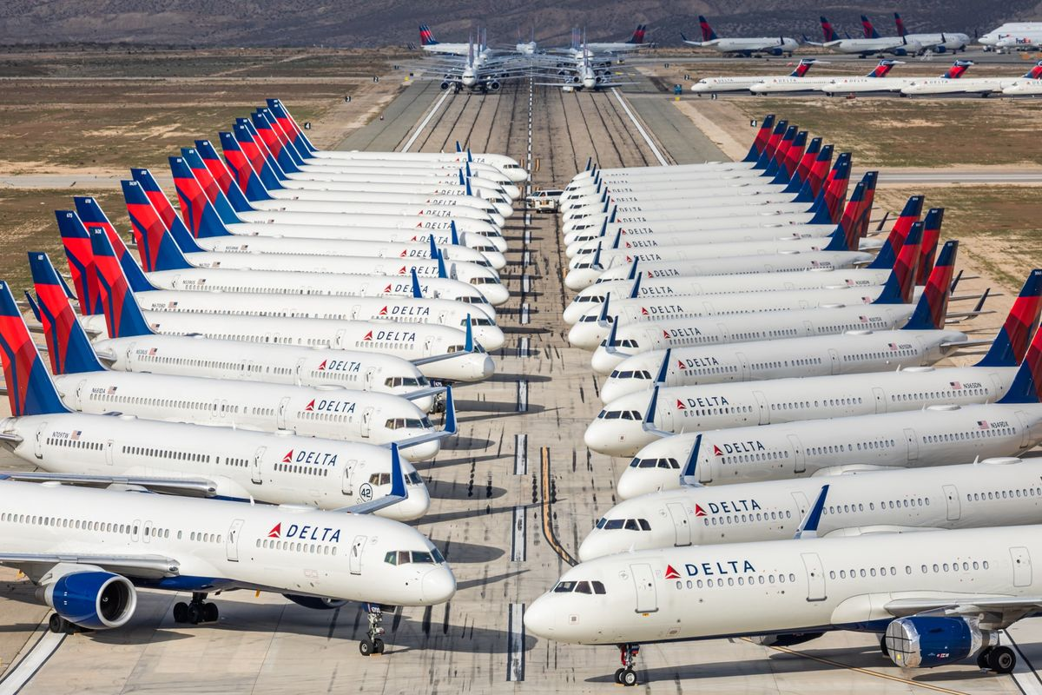
Impact on commercial and private traffic

Slide 16


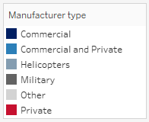

Slide 17

Impact on vertical flight efficiency and taxi-out time

Slide 18

Vertical Efficiency
Can be maximised by
Continuous climb operations: Aircraft climbs without interruption using optimal thrust until cruising altitude is reached
Continuous descent operations: Aircraft descends continuously using minimum thrust until it reaches the landing point
Benefits
Reduced emissions and lower noise pollution around cities

Slide 19
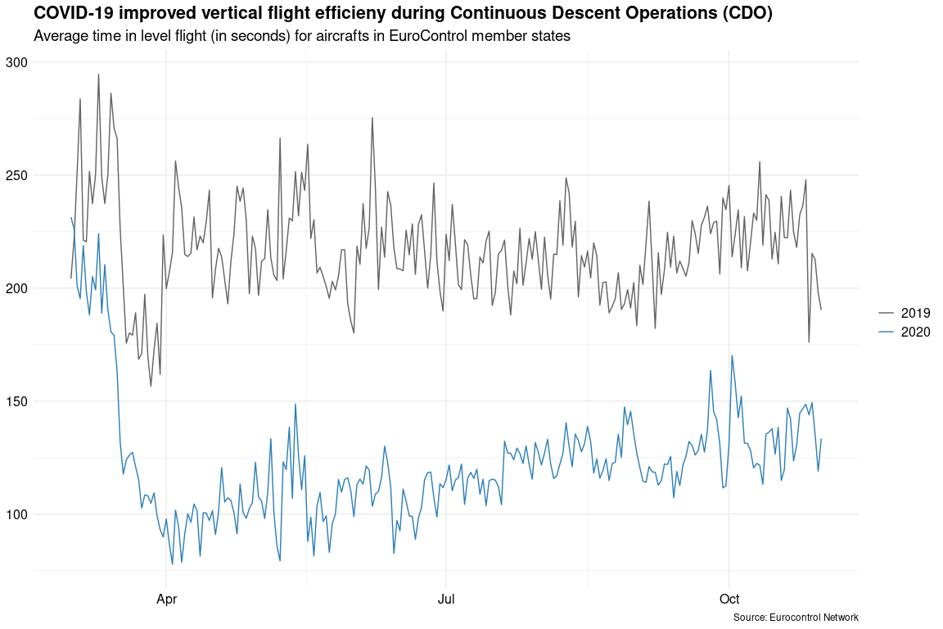

Slide 20
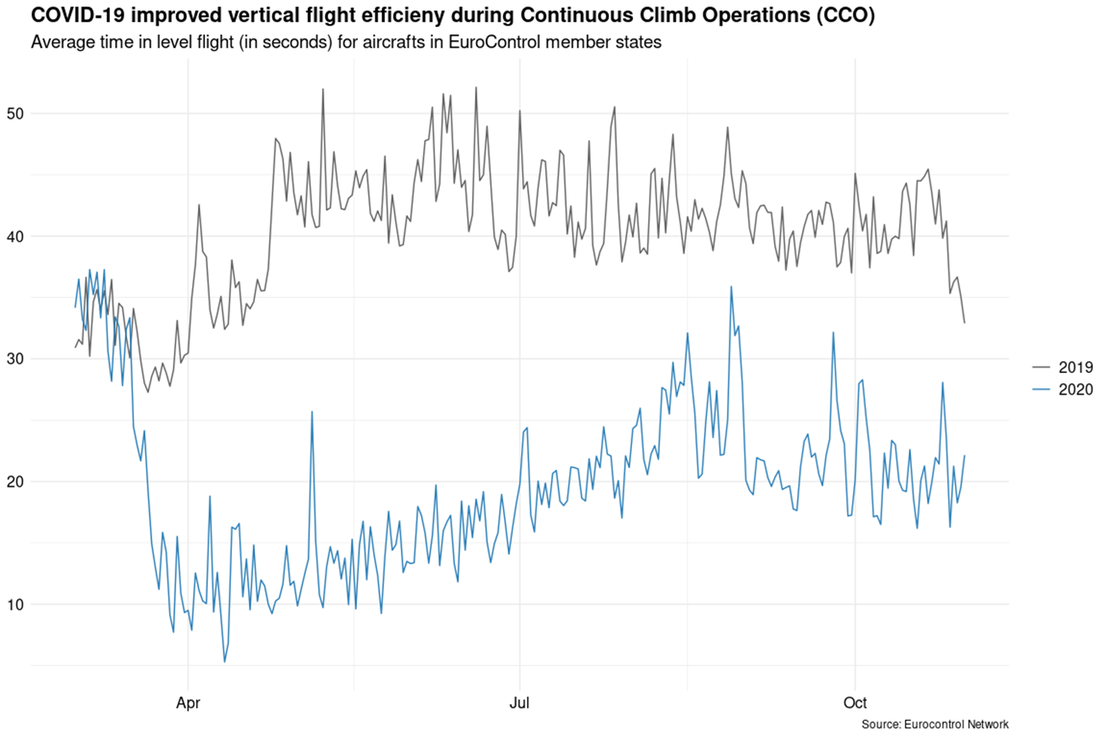

Slide 21
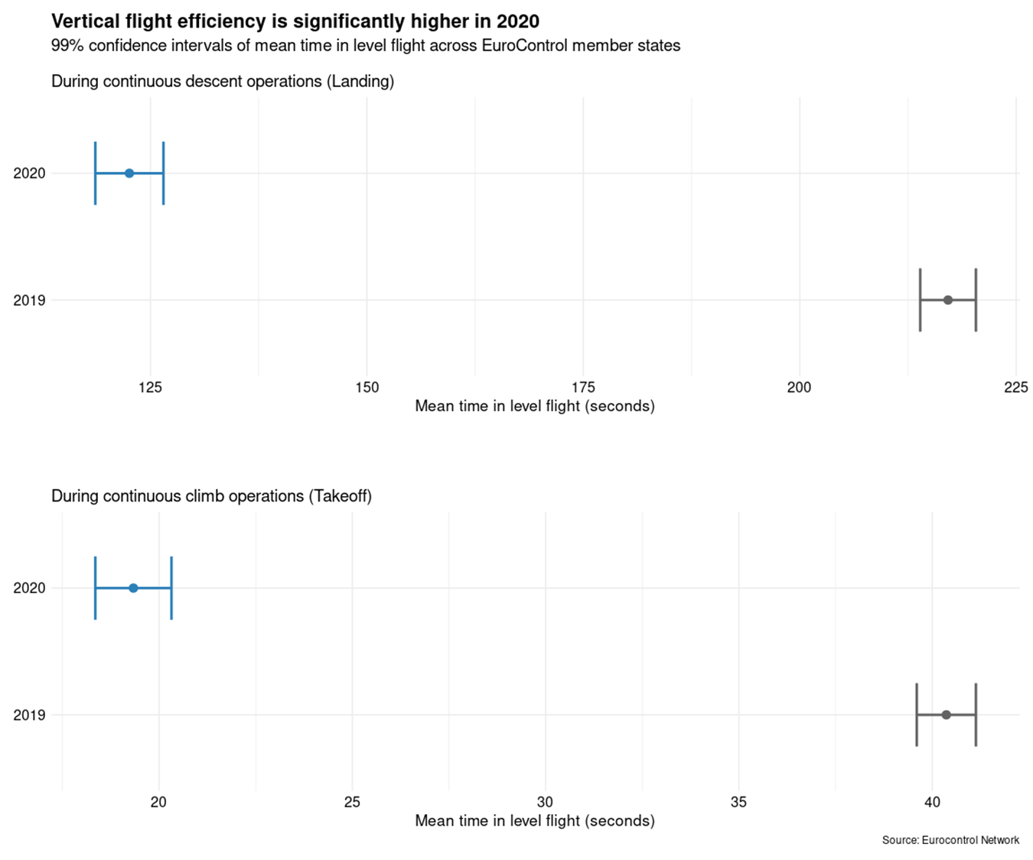
Based on an A320:
Roughly 33L fuel less per take-off

Slide 22
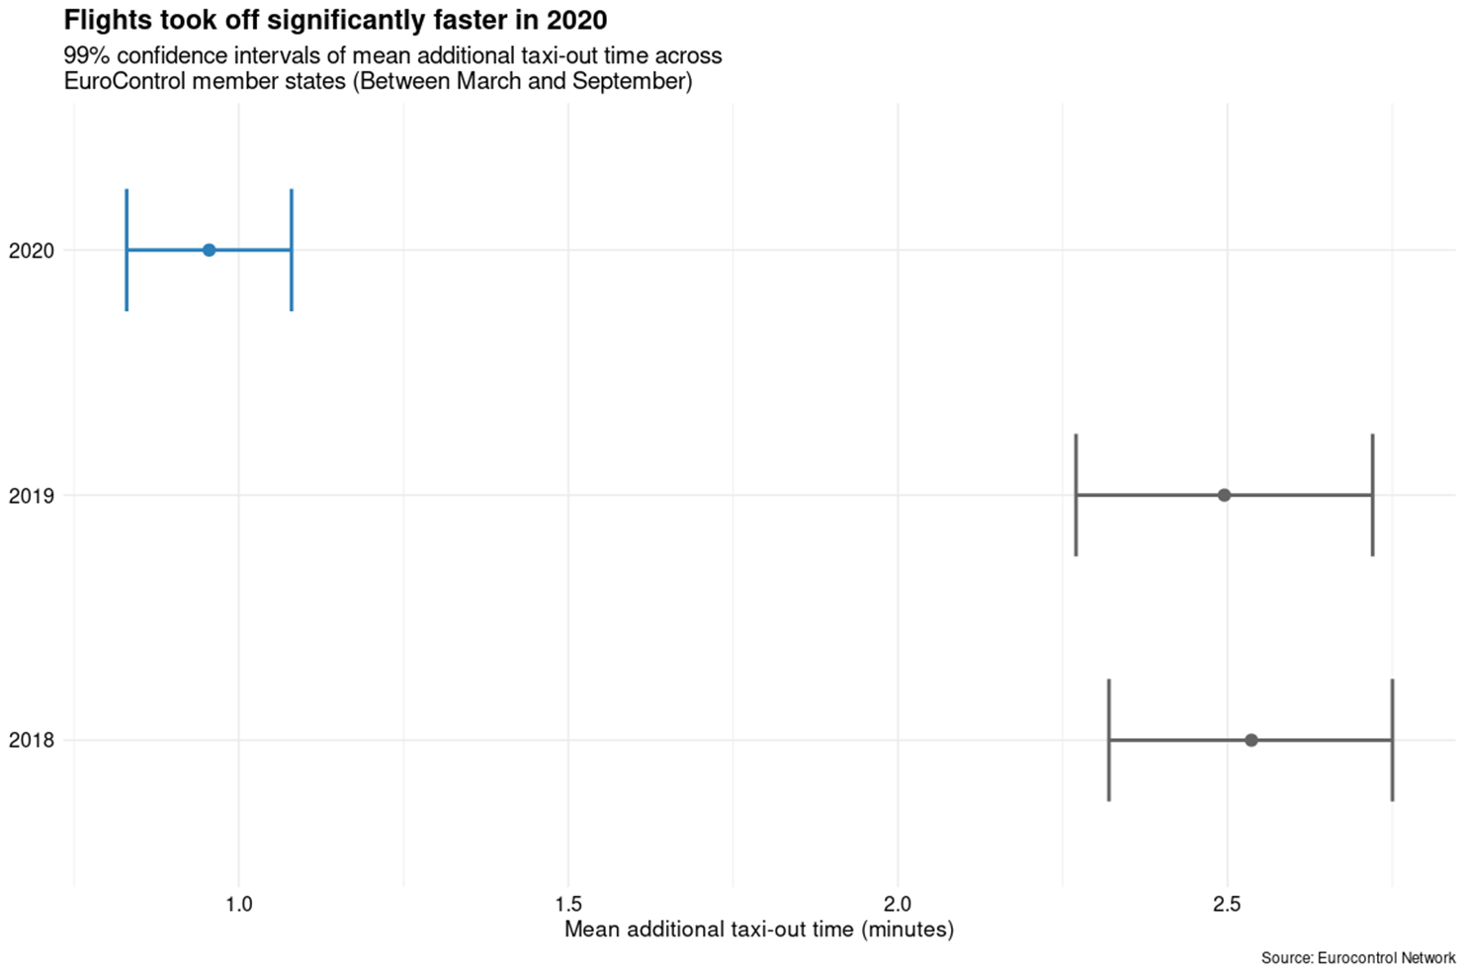

Slide 23
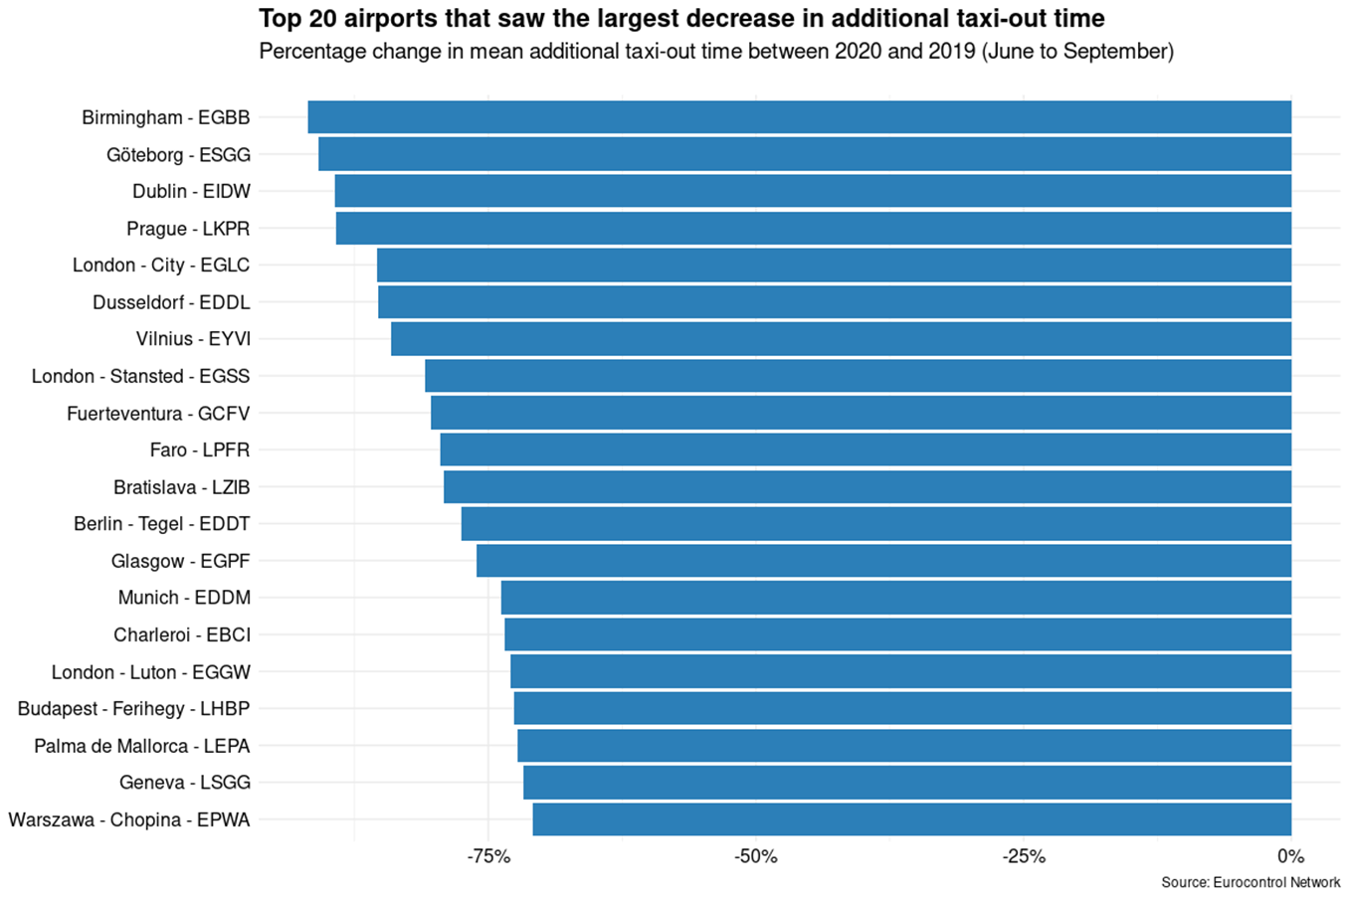

Slide 24

First Peak vs. Now
Trends of Confirmed Cases and Flights

Slide 25

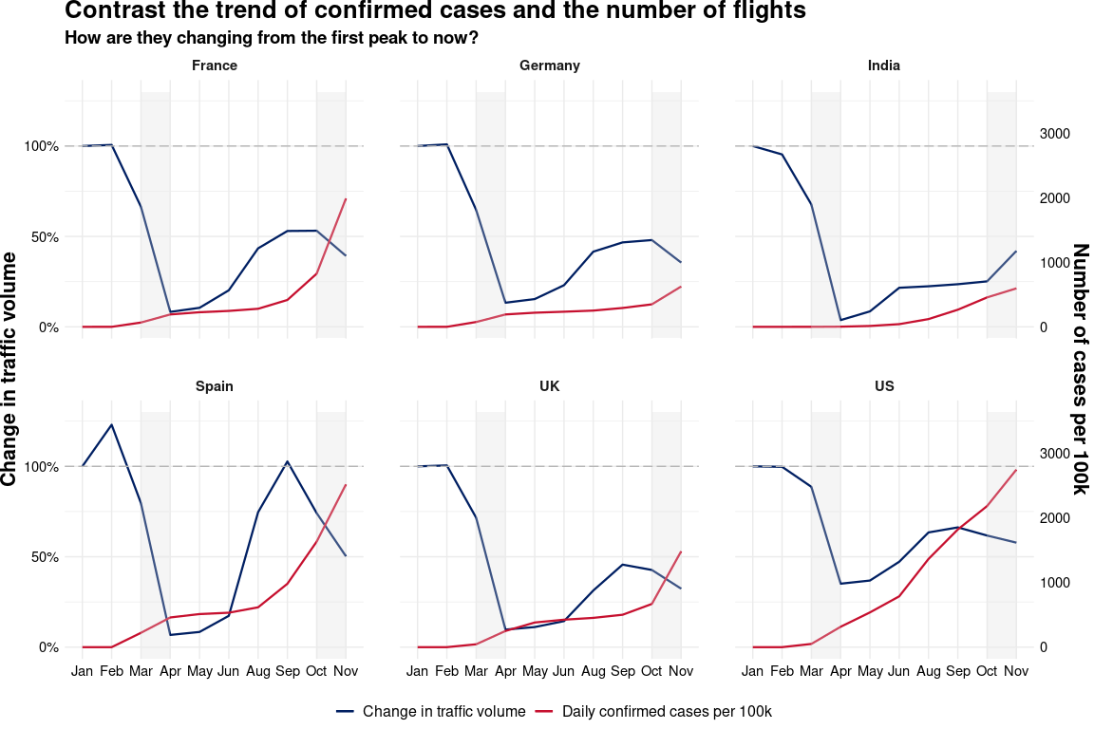

Slide 26

Results
The impact of COVID-19 has been much broader and deeper compared to the 2010 air traffic crisis and flight volumes have not yet recovered
Some of the longest and busiest air routes in the world saw flight volumes plummet compared to 2019’s numbers
Cessna briefly overtook Airbus in terms of global air traffic share in 2020 as commercial passenger flights came to a grinding halt
We can take comfort in knowing that the few flights which are still operational are able to taxi-out, take-off and land more efficiently due to clearer skies!

Slide 27

Lessons Learnt and Limitations
Working with a large dataset proved to be challenging and taught us the benefits of NoSQL databases systems
The dataset is very rich and our analysis could have benefitted from exploring the whole dataset with additional time and resources
Limited availability of crowd-sourced data in some countries
One year of pre-Covid19 flights data is not enough to grasp the seasonality and trends in air traffic

Slide 28

Links to Additional Content
Beautiful geospatial visualisations by the Washington Post
For spacious skies : How COVID-19 has rocked US domestic flights
How have SARS-CoV-2's limitations impacted global aviation traffic?
Our interactive Tableau notebook

Slide 29
References
https://www.paddleyourownkanoo.com/2020/05/02/as-united-airlines-announces-mandatory-face-masks-engineers-made-sure-a-boeing-787-complied-with-the-rules/
https://www.ecosia.org/images?q=herbs%20ingredients#id=91BDCBF3D9EA8A0885A04176991227C4135FF743
https://reisenexclusiv.com/flugtrackerseiten/
https://www.mdf-ag.com/presse/pressemitteilungen/page-10/
https://twitter.com/AManuelFerreira/status/1245336650768580617
https://www.schoenefeld-parkplatz.de/blog/flugzeug-start/
https://www.mdf-ag.com/presse/pressemitteilungen/page-10/
https://www.webmd.com/lung/coronavirus

Slide 30

Questions
Thank you and it´s now time for any open questions.

